Slide 1
Chapter 10
Launching the New Ship of State
1789-1800

Slide 2
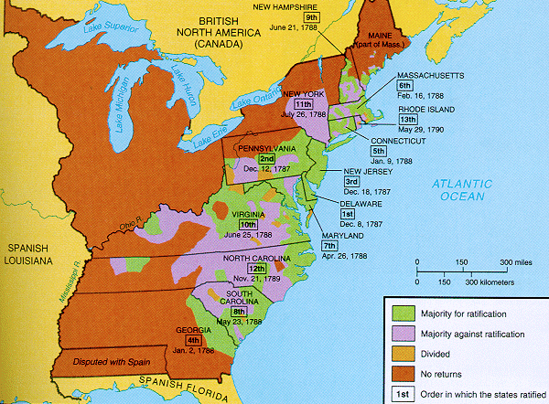
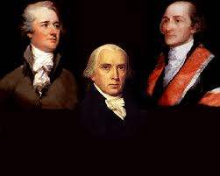
Ch. 9 Review: Federalists vs. Anti-federalists
Federalists: In favor of a strong central government (Madison, Hamilton, Washington, Jay, etc.)
Adult language present.
Anti-Federalists: In favor of a weaker central government with states having more power (Sam Adams, Patrick Henry)
Why did Anti-Federalists adopt the Constitution?
Federalists promised to add a Bill of Rights!!!!
Federalists Papers: pamphlet to gather support for the Constitution

Slide 3
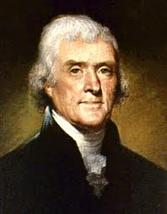
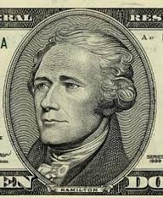
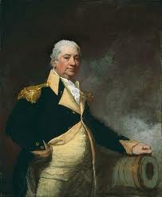
Washington as President
Established the cabinet:
Heads of various departments that offer advice
No where in Constitution is cabinet mentioned
State: Jefferson, Treasury: Hamilton, War: Henry Knox
Quarrels between Hamilton and Jefferson

Slide 4
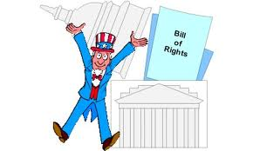
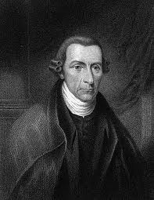
The Bill of Rights
James Madison created Bill of Rights
Promised to the anti-federalists if they supported the Constitution
Several freedoms, notably freedoms given to states (10th amendment): satisfied the anti-federalists

Slide 5

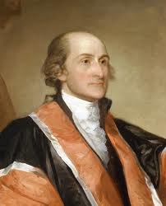
Judiciary Act of 1789
Organized the Supreme Court
1 chief justice and 5 associate justices
John Jay, writer of The Federalist Papers and a staunch Federalist, becomes the first Chief Justice

Slide 6
Customs Duties and Excise Taxes
How would Hamilton pay off the debts?
TAXES!
Hamilton liked the debt; more people that are owed $, more that wanted to see US do well
Tariffs: tax on foreign goods
Favors American Industry, who does it hurt?
Excise Tax: Tax on manufactured goods
Whiskey!

Slide 7
Hamilton Battles Jefferson
Bank Most important Hamilton v. Jefferson issue, would be private corporation, Government would be #1 shareholder
Jefferson believed in a strict interpretation of the Constitution
Unless Constitution specifically states something, federal government can’t do it then.
Hamilton’s response:
“Necessary and Proper”, or “Elastic Clause”
What Constitution did not forbid, it allowed
Loose interpretation

Slide 8
Memory Aid for Hamilton’s Plan
BE FAT – Excuse me?
Bank of the U.S.
Excise Taxes
Funding at Par
Assumption of State Debts
Tariffs

Slide 9
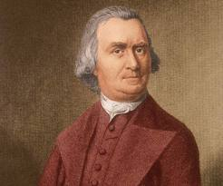
Whiskey Rebellion!!!!
Southwestern PA rebellion against high excise tax
Tarred and feathered revenue officers
Similar to what group prior to the Revolution?
Washington sends in troops and crushes the rebellion
***Shows the power of the new federal government***
What prior rebellion showed the weakness of the Articles?
Shays’ Rebellion

Slide 10
***Washington’s Neutrality***
Franco-American Alliance of 1778 bound US to defend French West Indies against foes
Washington and Hamilton wanted to avoid war with England
Country was not strong enough yet
Issued Neutrality proclamation and encouraged Americans to be impartial as well

Slide 11
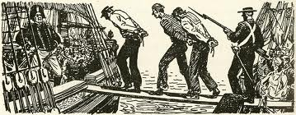
Problems with Britain
England encouraged Natives to attack US, when attacks failed, England does not help Native
Treaty of Greenville:
Natives give up land in Old Northwest
Britain promised to abandon posts
Britain Impressed American merchant ships
Forced Americans to join British military
Future cause of War of 1812

Slide 12
Treaties and Washington
Britain promises to leave posts (forts), pay damages for seized ships
Makes southerners mad: New England gets ships paid for, South still has to pay war debt
Pickney’s Treaty:
Treaty with Spain, granted Americans navigation on Mississippi, land north of Florida
Washington’s Precedents:
2 term tradition
Avoidance of “permanent alliances”

Slide 13
Unofficial fighting with France
French are mad about Jay’s Treaty
XYZ Affair
John Marshall (future chief justice) tries to reach agreement with France
Met by three agents, wanted $250,000 to talk to Foreign Minister Talleyrand
Marshall refuses, comes back a hero
War hysteria ensues

Slide 14
Alien and Sedition Acts
Alien Acts:
Required residency to increase from 5 years to 14
Hurt Jeffersonians since it limited the voter pool
President could deport foreigners and imprison them in times of war
Sedition Acts:
Heavy fines and imprisonment for anyone who criticizes government officials
Direct violation of 1st amendment
Expired after 2 years
Both Acts were used to limit the power/influence of Jeffersonians

Slide 15
Virginia and Kentucky Resolutions
Premise: States had right to nullify unconstitutional laws passed by Congress
Significance:
Later used by southerners to support nullification and ultimately secession prior to Civil War.

Slide 16
Good Luck On Your Exam!

